Slide 1

HWRF Idealized Capability
HWRF v3.7a Tutorial
Nanjing, China, December 2, 2015
L. Bernardet
NOAA ESRL Global Systems Division, Boulder CO
University of Colorado CIRES , Boulder CO
Acknowledgements
Sara Michelson (NOAA ESRL/PSD & CU/CIRES)
Young Kwon (formerly from NOAA EMC)

Slide 2
Overview of idealized capability
Initialization uses a prescribed vortex superposed onto a quiescent environment. Default
Max intensity of 20 ms⁻¹
Radius of maximum winds (RMW) - 90 km
The model configuration is same as the real run
Three domains with telescopic nests
f- or β-plane
Lower boundary is water (no land masses)
Sea surface temperature
time-invariant (no ocean coupling)
horizontally homogeneous
default =302 K
Uses: research and development

Slide 3
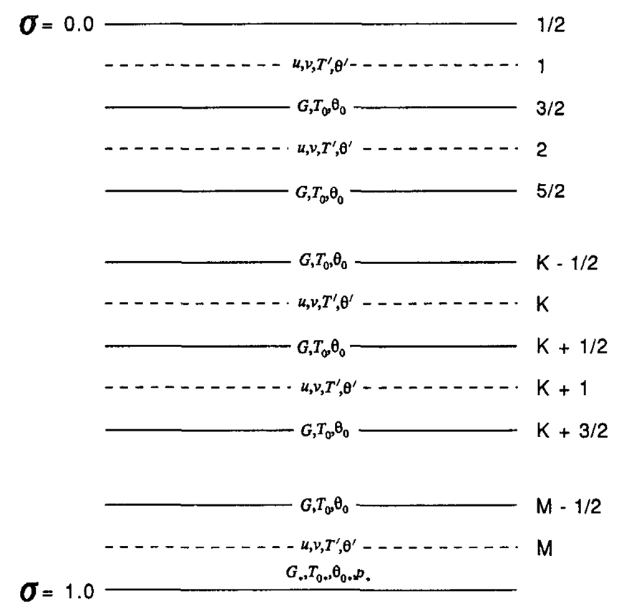
Creation of the idealized vortex - I
Wang, Y., 1995: An inverse balance equation in sigma coordinates for model initialization Mon. Wea. Rev., 123, 482–488.
The vortex is based on the balance equation relating prescribed wind fields to mass fields
The atmosphere is divided into M layers in the sigma coordinate system.
The initial background state temperature (T_{o}) along with a prescribed forcing term (G) in the balance equation are defined at the interfaces of the model layers.
The initial vortex winds along with the temperature perturbation (T’), derived from the background state are defined at mid-levels levels between the interfaces.

Slide 4
Creation of the idealized vortex - II
The wind field of the initial vortex is prescribed in cylindrical polar coordinates by:
where V_{m} is the maximum wind at the surface, r_{m} is the radius of maximum wind, r is the radius from the vortex center, and b = 1.
The forcing term in the balance equation is given by:
where J is the Jacobian, f is the Coriolis parameter, ζ is the vorticity and β is the meridional gradient of the Coriolis parameter.

Slide 5
Creation of the idealized vortex - III
The pressure at σ = 1 is obtained by solving the Poisson equation:
where subscript d denotes the variable evaluated at σ = 1.
The temperature perturbations at the rest of the sigma levels are determined by solving Poisson equation:
Finally, using the non-hydrostatic approximation, the geopotential heights are obtained from the total temperature and moisture fields.

Slide 6
Code and scripts
WPS
geogrid.exe, ungrib.exe, mod_levs.exe, metgrid.exe
No vortex initialization, data assimilation, or ocean
WRF
Must compile HWRF with IDEAL_NMM_TC=1
Specifying ./compile nmm_tropical_cyclone on the command line
wrf.exe, ideal.exe (cannot use wrf.exe from real compilation)
UPP and graphics
Scripts
Do not use the wrappers in hwrf-utilities to run
They use invoke the vortex initialization (not needed for idealized)
Just run executables (all in command line; except wrf.exe in batch)
Use a script to run UPP and generate GrADS graphics
Notes:
UPP and graphics?

Slide 7
Input files
Two GFS GRIB files to provide a template for IC and LBC
Files gfs.t12z.pgrb2.0p25.f000 and gfs.t12z.pgrb2.0p25.f126
Files in WRFV3_idealized/test/nmm_tropical_cyclone
Namelist file for WPS: namelist.wps
Namelist file for WRF: namelist.input
Vortex description file: input.d
Intensity, RMW, f or β plane
Sounding data: sound.d
30 levels (or change number of levels in code)
Vortex center file: storm.center
Sigma file: sigma.d
Do not change this file
Lookup tables for running WRF in hwrf-utilities/parm

Slide 8
Idealized model initialization
Use WPS (geogrid) to setup domain
Use WPS (ungrib, mod_levs, and metgrid) to process GFS for IC/LBC
mod_levs is used to reduce data in GFS file to expedite processing
Outputs are just a template to add the environment and vortex
Use ideal.exe to create the actual IC and LBC (wrfiput and wrfbdy)
LBC are quiescent. This inevitably leads to some reflection when waves emanating from the vortex reach the outer domain boundaries

Slide 9
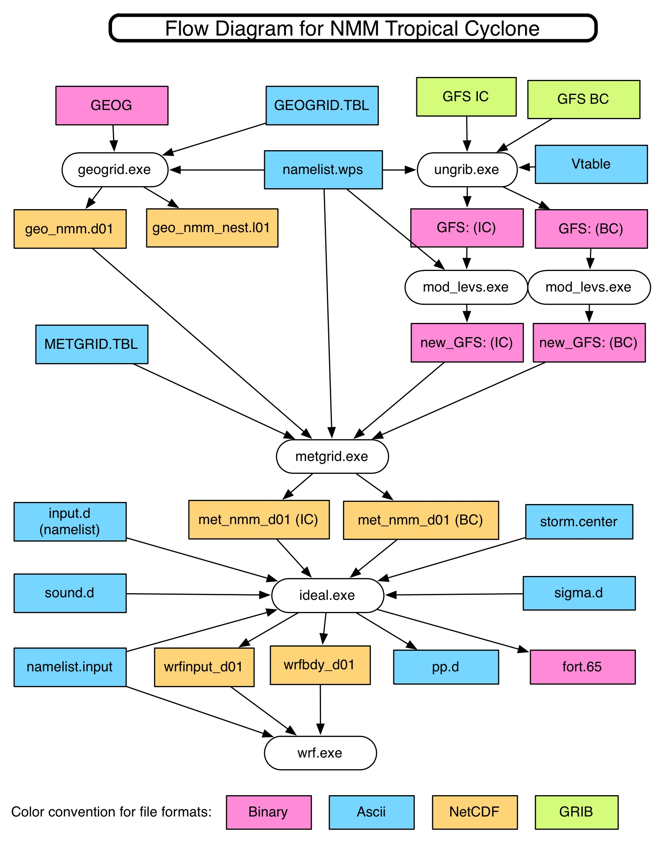
Notes:
Remove mod levs

Slide 10
Working directories
Will need a working directory
workdir = /glade/scratch/${USER}/Idealized
Subdirectories
WRFV3
WPSV3
wpsprd (for running WPS: geogrid, ungrib, mod_levs, metgrid)
wrfprd (for running ideal and wrf)

Slide 11
Submitting to batch system
geogrid.exe, ungrib.exe, mod_levs.exe, metgrid.exe, ideal.exe
Executables can be run on command line
wrf.exe
Will be submitted to the batch system
Notes:
Script for running postprocessing???

Slide 12
Running geogrid
Enter the working directory
cd $workdir/wpsprd
Copy the WPS namelist
cp ${WORKDIR}/ WRFV3/test/nmm_tropical_cyclone/namelist.wps .
Edit namelist.wps and set path
geog_data_path = location of file
Run executable geogrid.exe on a compute node or batch system
${WORKDIR}/WPSV3/geogrid.exe
Verify that the output files were created
ls -l geo_nmm.d01.nc geo_nmm_nest.l01.nc \ geo_nmm_nest.l02.nc

Slide 13
Running ungrib
Link the ungrib table
ln –fs ${WORKDIR}/WPSV3/ungrib/Variable_Tables/Vtable.GFS Vtable
Link the two input GFS files
ln -fs ${DATA}/gfs.t12z.pgrb2.0p25.f* .
Link the GFS files to the names expected by ungrib
${WORKDIR}WPSV3/link_grib.csh gfs.t12z.pgrb2.0p25.f000 \ gfs.t12z.pgrb2.0p25.f120
ls -l GRIBFILE.AAA GRIBFILE.AAB
Run ungrib
${WORKDIR}/WPSV3/ungrib.exe
Verify that the output files were created
ls -l GFS:2012-10-26_12 GFS:2012-10-31_12
Notes:
Name of data files
Need to extract from tarball?

Slide 14
Running mod_levls
Run mod_levs. Not MPI job, so does not require batch system
${WORKDIR}/WPSV3/util/mod_levs.exe GFS:2012-10-26_12 new_GFS:2012-10-26_12 ${WORKDIR}/WPSV3/util/mod_levs.exe GFS:2012-10-31_12 new_GFS:2012-10-31_12
Verify that the output files were created
ls -l new_GFS:2012-10-26_12 new_GFS:2012-10-31_12
Note: only the levels listed in variable press_pa in namelist.wps will be retained.

Slide 15
Running metgrid
Link the metgrid table
ln –fs ${WORKDIR}/WPSV3/metgrid/METGRID.TBL.NMM ./METGRID.TBL
Edit namelist.wps set paths
opt_metgrid_tbl_path = = ‘.’
Run metgrid
${WORKDIR}/WPSV3/metgrid.exe
Verify that the output files were created
ls -l met_nmm.d01.2012-10-26_12_00_00.nc \ met_nmm.d01.2012-10-31_12_00_00.nc

Slide 16
Running ideal - I
Enter the working directory
cd $workdir/wrfprd
Link WRF input files
ln -fs ${WORKDIR}/WRFV3/run/ETAMPNEW_DATA ./ ln -fs ${WORKDIR}/WRFV3/run/ETAMPNEW_DATA.expanded_rain ./ ln -fs ${WORKDIR}/WRFV3/run/GENPARM.TBL ./ ln -fs ${WORKDIR}/WRFV3/run/LANDUSE.TBL ./ ln -fs ${WORKDIR}/WRFV3/run/SOILPARM.TBL ./ ln -fs ${WORKDIR}/WRFV3/run/VEGPARM.TBL ./ ln -fs ${WORKDIR}/WRFV3/run/tr49t67 ./ ln -fs ${WORKDIR}/WRFV3/run/tr49t85 ./ ln -fs ${WORKDIR}/WRFV3/run/tr67t85 ./ ln -fs ${WORKDIR}/WRFV3/run/ozone.formatted ./ ln -fs ${WORKDIR}/WRFV3/run/ozone_lat.formatted ./ ln -fs ${WORKDIR}/WRFV3/run/ozone_plev.formatted ./ ln -fs ${WORKDIR}/WRFV3/run/RRTM_DATA ./ ln -fs ${WORKDIR}/WRFV3/run/RRTMG_LW_DATA ./ ln -fs ${WORKDIR}/WRFV3/run/RRTMG_SW_DATA ./

Slide 17
Running ideal - II
Link the WPS files
ln -fs ${WORKDIR}/wpsprd/met_nmm* .
ln -fs ${WORKDIR}/wpsprd/geo_nmm* .
Copy namelist input
cp ${WORKDIR}/WRFV3/test/nmm_tropical_cyclone/namelist.input .

Slide 18
Running ideal - III
Copy the idealized simulation input files
cp ${WORKDIR}/WRFV3/test/nmm_tropical_cyclone/input.d .
cp ${WORKDIR}/WRFV3/test/nmm_tropical_cyclone/sigma.d .
cp ${WORKDIR}/WRFV3/test/nmm_tropical_cyclone/sound.d .
cp ${WORKDIR}/WRFV3/test/nmm_tropical_cyclone/storm.center .
Edit and modify files input.d, sound.d, if desired
File storm.center should not be altered (storm in center of inner nest)
File sigma.d should not be altered (vertical levels to create the initial vortex)
Run ideal.exe using script to submit it to batch queue
${WORKDIR}/WRFV3/main/ideal.exe
Verify that the output files were created
ls –l wrfinput_d01 wrfbdy_d01 fort.65

Slide 19
Running WRF
Run wrf.exe using script to submit it to batch queue
bsub < run.wrf.ideal.csh
Verify that the output files were created
ls –l wrfout_d01* wrfout_d02* wrfout_d03*

